Slide 1
Writing Basic SQL Select Statements

Slide 2
Lecture Plan
SQL Fundamentals
SQL Characterization
SQL SELECT Statement
Tutorial Questions

Slide 3
SQL Fundamentals
Structured Query Language (SQL) is a standard language for accessing and manipulating databases.
SQL has been standardised by ANSI and has been adopted as an industry standard for relational database systems.
The basic structure of data stored in any database is in the form of TABLES.

Slide 4
SQL Fundamentals
A particular table in any database consists of ROWS and COLUMNS
Rows
RC₁₁ | RC₁₂ | … | RC_{1n}
RC₂₁ | RC₂₂ | … | RC_{2n}
RC₃₁ | RC₃₂ | … | RC_{3n}
RC_{m1} | RC_{m2} | … | RC_{mn}
Columns

Slide 5
SQL Fundamentals
A row in a table represents set of data associated with a particular entity.
A column in a table represents the characteristics of the data.

Slide 6
SQL Characterization
SQL comprised of various statements to manage and create databases.
The SQL statements are characterised under two main heads these are:
Data Manipulation Language (DML)
Data Definition Language (DDL)

Slide 7
SQL Characterization
Data Manipulation Language (DML) is used to retrieve, modify and insert information from or into the database.
The SQL statements which fall under the DML category are as follows:
SELECT Statement
INSERT Statement
UPDATE Statement
DELETE Statement

Slide 8
SQL SELECT Statement
SQL Select statement is used to retrieve information from the database table.
Syntax:
SELECT [* | DISTINCT] columnname1 [, columnname2]
FROM tablename1 [, tablename2]
[WHERE condition] [And | or | LIKE condition . . .]
[GROUP BY column-list]
[HAVING “conditions”]
[ORDER BY “condition-list” [ASC | DESC]]

Slide 9
SQL SELECT Statement
Explanation:
SELECT | is a keyword to retrieve one or more columns
* | selects all columns
DISTINCT | supresses duplicate data
Columnname1…N | represents the specific column name to be retrieved
FROM tablename1…N | specifies the table name which contains the columns
WHERE condition | specifies the condition for the selection of data
GROUP BY | allows multiple columns to be grouped
HAVING | specifies condition for the GROUP BY clause
ORDER BY | arrange the output data in ascending/descending order

Slide 10
SQL SELECT Statement
A simpler syntax for Select statement can be:
SELECT columnname1 [, columnname2]
FROM tablename1 [, tablename2]

Slide 11
SQL SELECT Statement
Capabilities of SQL Select Statements
Projection
Selection
Joining

Slide 12
SQL SELECT Statement
Displaying All columns in a table.
SELECT *
FROM Author;
OR
SELECT Author_id, Fname, Lname
FROM Author;

Slide 13
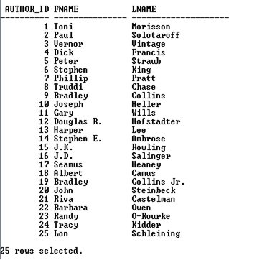

Slide 14
SQL SELECT Statement
Displaying specific columns in a table
SELECT P_Name, City
FROM Publisher;

Slide 15


Slide 16
SQL SELECT Statement
Assigning alias to a column in a table
SELECT P_Name AS “Publisher’s Name”,
City
FROM Publisher;

Slide 17


Slide 18
SQL SELECT Statement
Displaying data with arithmetic calculation.
SELECT B_Code, Title, Price, Price*10/100 AS “Student Discount”
FROM Books;
OR
SELECT B_Code, Title, Price, (Price*10)/100 AS “Student Discount”
FROM Books;

Slide 19
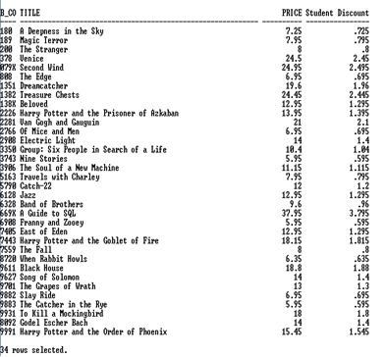

Slide 20
SQL SELECT Statement
Concatenating two columns in a table.
SELECT Fname || Lname AS “Author Name”
FROM Author;

Slide 21
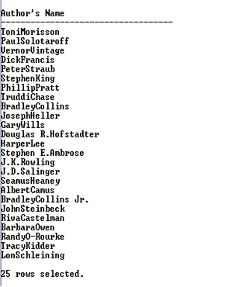

Slide 22
SQL SELECT Statement
Display data by using Literals.
SELECT Title || ‘ published by ‘|| P_Code AS “Books Details”
FROM Books;

Slide 23
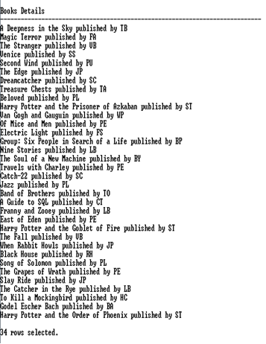

Slide 24
SQL SELECT Statement
Displaying DISTINCT records in a table.
SELECT DISTINCT Publisher
FROM Books;

Slide 25
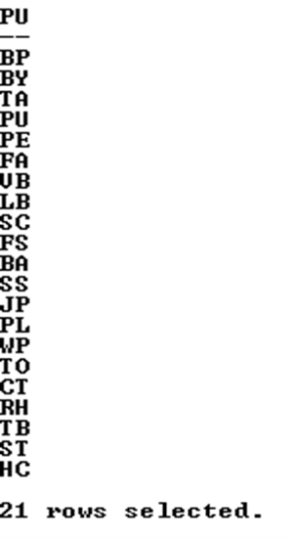

Slide 26
SQL SELECT Statement
Displaying table Structure
DESCRIBE Books;
OR
DESC Books;

Slide 27
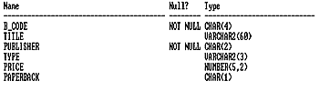

Slide 28

SQL SELECT Statement
Using DUAL table.
SELECT SYSDATE, USER
FROM dual;

Slide 29
Tutorial Questions

